Slide 1
Elements of Econometrics. Lecture 2. Simple Linear Regression Model.
ICEF, 2022-2023

Slide 2
Linear Relationships Examples: World Development Indicators 2022 https://databank.worldbank.org/source/world-development-indicators
The relationships of Gini (2019) and real GDP growth rates (2019), and of Real GDP (PPP) per capita and Life expectancy at birth (2020)

Slide 3




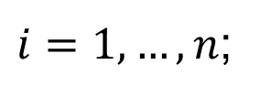




Terminology for the Linear Regression Model with a Single Regressor
The linear regression model is :
where the subscript runs over observations
is the dependent variable, the regressand, of simply the left-hand variable;
is the independent variable, the regressor, of simply the right-hand variable;
is the population regression line or population regression function ;
is the intercept of the population regression line;
is the slope of the population regression line;
is the error term.
$$Y_{i}=β_{1}+β_{2}X_{i}+u_{i}$$
$$i$$
$i=1,…,n$;
$$Y_{i}$$
$$X_{i}$$
$$β_{1}+β_{2}X_{i}$$
$$β_{1}$$
$$β_{2}$$
$$u_{i}$$

Slide 4


ASSUMPTIONS FOR MODEL A
Model A: Cross-sectional data with nonstochastic regressors.
A.1 The model is linear in parameters and correctly specified.
A.2 There is some variation in the regressor in the sample.
A.3 The disturbance term has zero expected value in each observation:
for all i (Gauss-Markov 1 condition)
$$Y=β_{1}+β_{2}X+u$$
$$E\left(u_{i}\right)=0$$

Slide 5
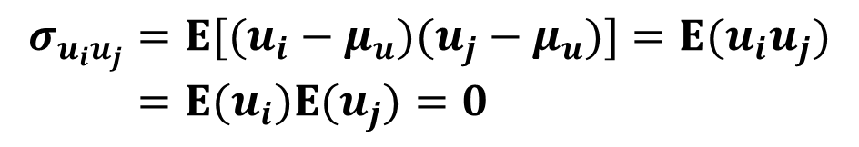

ASSUMPTIONS FOR MODEL A (continued)
A.4 The disturbance term is homoscedastic
for all i (Gauss-Markov 2 condition)
A.5 The values of the disturbance term have independent distributions (u_{i} and u_{j} are independent for all j ≠ i) (Gauss-Markov 3 condition)
A.6 The disturbance term has a normal distribution
$$σ_{u_{i}}^{2}=σ_{u}^{2}$$
$$σ_{u_{i}u_{j}}=E[(u_{i}−μ_{u})(u_{j}−μ_{u})]=E(u_{i}u_{j}) \\ =E(u_{i})E(u_{j})=0$$

Slide 6




SIMPLE LINEAR REGRESSION MODEL
Y (actual value)
Y
$$\hat{Y}$$
(fitted value)
P₄
$$\hat{Y}=b_{1}+b_{2}X$$
R₃
R₄
R₂
P₁
$$Y−\hat{Y}=\hat{u}$$
R₁
P₃
b₁
P₂
X₁
X₂
X₃
X₄
X
The line is called the fitted model and the values of Y predicted by it are called the fitted
values of Y. The differences are called residuals
$${\hat{u}}_{i}$$

Slide 7




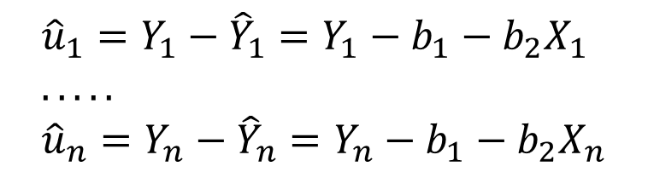




DERIVING LINEAR REGRESSION COEFFICIENTS
True model
Y
$$Y=β_{1}+β_{2}X+u$$
Fitted model
$$\hat{Y}=b_{1}+b_{2}X$$
$${\hat{Y}}_{n}=b_{1}+b_{2}X_{n}$$
$${\hat{u}}_{n}$$
$$Y_{n}$$
$$Y_{1}$$
$${\hat{u}}_{1}=Y_{1}−{\hat{Y}}_{1}=Y_{1}−b_{1}−b_{2}X_{1} \\ ..... \\ {\hat{u}}_{n}=Y_{n}−{\hat{Y}}_{n}=Y_{n}−b_{1}−b_{2}X_{n}$$
$${\hat{u}}_{1}$$
$${\hat{Y}}_{1}=b_{1}+b_{2}X_{1}$$
b₂
b₁
X₁
X_{n}
X

Slide 8
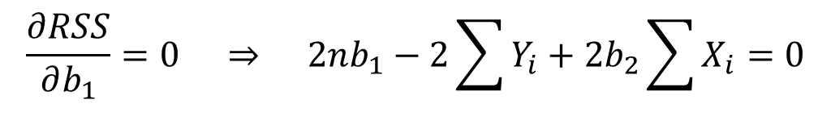
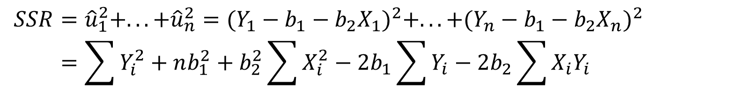

DERIVING LINEAR REGRESSION COEFFICIENTS
$$SSR={\hat{u}}_{1}^{2}+...+{\hat{u}}_{n}^{2}=(Y_{1}−b_{1}−b_{2}X_{1})^{2}+...+(Y_{n}−b_{1}−b_{2}X_{n})^{2} \\ =\sum{Y_{i}^{2}}+nb_{1}^{2}+b_{2}^{2}\sum{X_{i}^{2}}−2b_{1}\sum{Y_{i}}−2b_{2}\sum{X_{i}Y_{i}}+2b_{1}b_{2}\sum{X_{i}}$$
$$\frac{∂RSS}{∂b_{1}}=0 ⇒ 2nb_{1}−2\sum{Y_{i}}+2b_{2}\sum{X_{i}}=0$$
$$b_{1}=\bar{Y}−b_{2}\bar{X}$$

Slide 9
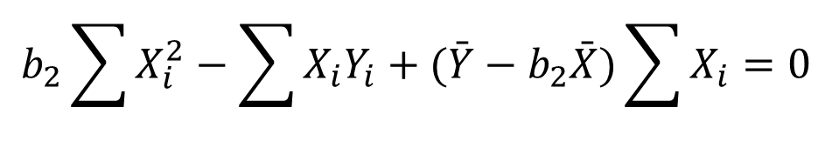

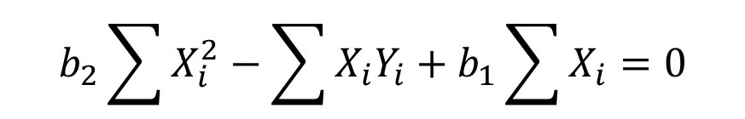
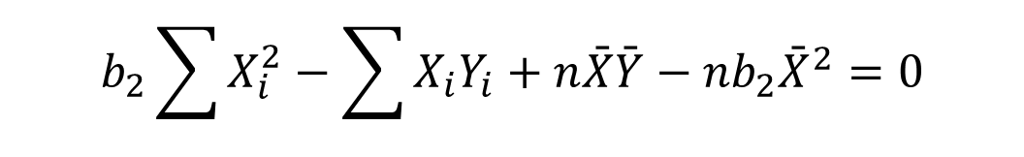
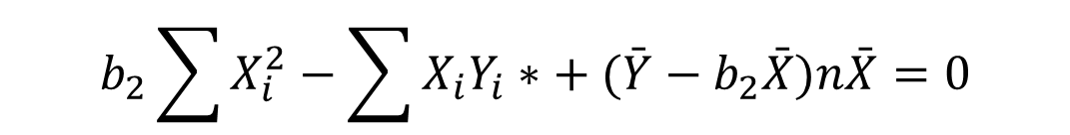
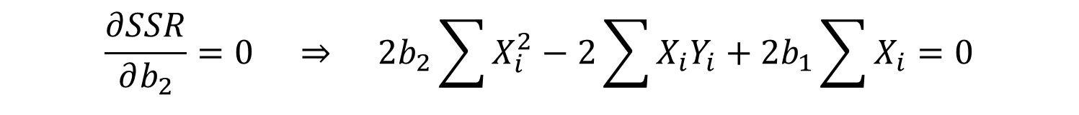
DERIVING LINEAR REGRESSION COEFFICIENTS
$$\frac{∂SSR}{∂b_{2}}=0 ⇒ 2b_{2}\sum{X_{i}^{2}}−2\sum{X_{i}Y_{i}}+2b_{1}\sum{X_{i}}=0$$
$$b_{2}\sum{X_{i}^{2}}−\sum{X_{i}Y_{i}}+b_{1}\sum{X_{i}}=0$$
$$b_{2}\sum{X_{i}^{2}}−\sum{X_{i}Y_{i}}+(\bar{Y}−b_{2}\bar{X})\sum{X_{i}}=0$$
$$b_{2}\sum{X_{i}^{2}}−\sum{X_{i}Y_{i}∗}+(\bar{Y}−b_{2}\bar{X})n\bar{X}=0$$
$$b_{2}\sum{X_{i}^{2}}−\sum{X_{i}Y_{i}}+n\bar{X}\bar{Y}−nb_{2}{\bar{X}}^{2}=0$$
$$b_{2}\left(\sum{X_{i}^{2}}−n{\bar{X}}^{2}\right)=\sum{X_{i}Y_{i}}−n\bar{X}\bar{Y}$$

Slide 10
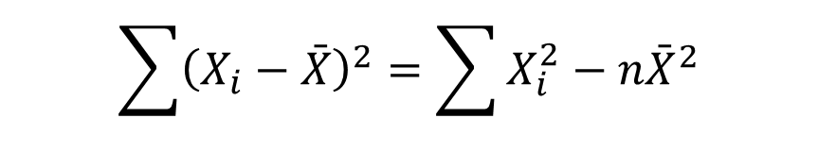
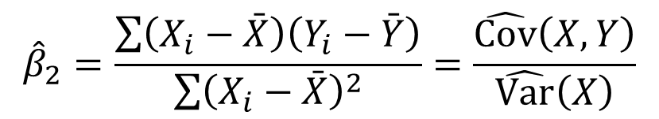
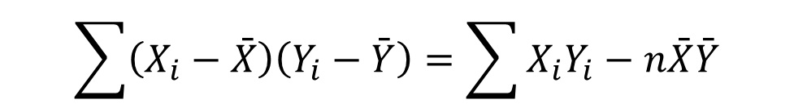
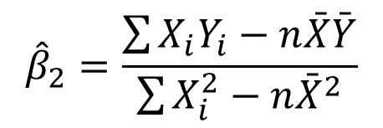

DERIVING LINEAR REGRESSION COEFFICIENTS
$${\hat{β}}_{2}\left(\sum{X_{i}^{2}}−n{\bar{X}}^{2}\right)=\sum{X_{i}Y_{i}}−n\bar{X}\bar{Y}$$
$${\hat{β}}_{2}=\frac{\sum{X_{i}Y_{i}}−n\bar{X}\bar{Y}}{\sum{X_{i}^{2}}−n{\bar{X}}^{2}}$$
$${\hat{β}}_{2}=\frac{\sum{\left(X_{i}−\bar{X}\right)\left(Y_{i}−\bar{Y}\right)}}{\sum{{\left(X_{i}−\bar{X}\right)}^{2}}}=\frac{\hat{Cov}\left(X,Y\right)}{\hat{Var}\left(X\right)}$$
$$\sum{\left(X_{i}−\bar{X}\right)\left(Y_{i}−\bar{Y}\right)}=\sum{X_{i}Y_{i}}−n\bar{X}\bar{Y}$$
$$\sum{{\left(X_{i}−\bar{X}\right)}^{2}}=\sum{X_{i}^{2}}−n{\bar{X}}^{2}$$

Slide 11



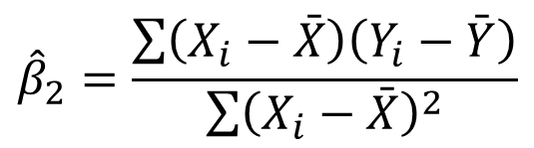





DERIVED LINEAR REGRESSION COEFFICIENTS
True model
Y
$$Y=β_{1}+β_{2}X+u$$
Fitted model
$$\hat{Y}={\hat{β}}_{1}+{\hat{β}}_{2}X$$
$${\hat{Y}}_{n}={\hat{β}}_{1}+{\hat{β}}_{2}X_{n}$$
$$Y_{n}$$
$$Y_{1}$$
$${\hat{β}}_{1}=\bar{Y}−{\hat{β}}_{2}\bar{X}$$
$${\hat{Y}}_{1}={\hat{β}}_{1}+{\hat{β}}_{2}X_{1}$$
$${\hat{β}}_{2}=\frac{\sum{\left(X_{i}−\bar{X}\right)\left(Y_{i}−\bar{Y}\right)}}{\sum{{\left(X_{i}−\bar{X}\right)}^{2}}}$$
$${\hat{β}}_{2}$$
$${\hat{β}}_{1}$$
X₁
X_{n}
X

Slide 12

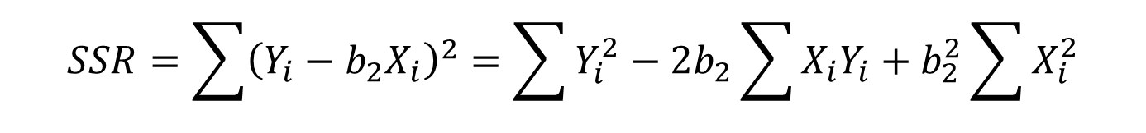



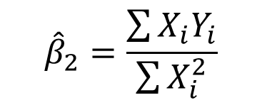
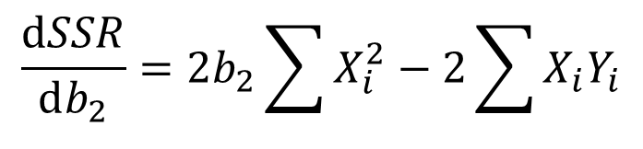
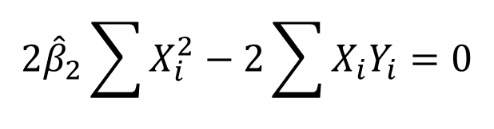
LINEAR REGRESSION MODEL WITHOUT INTERCEPT: DERIVING COEFFICIENTS
True model Fitted model
$$Y=β_{2}X+u$$
$$\hat{Y}={\hat{β}}_{2}X$$
$${\hat{u}}_{i}=Y_{i}−{\hat{Y}}_{i}=Y_{i}−b_{2}X_{i}$$
$$SSR=\sum{{\left(Y_{i}−b_{2}X_{i}\right)}^{2}}=\sum{Y_{i}^{2}}−2b_{2}\sum{X_{i}Y_{i}}+b_{2}^{2}\sum{X_{i}^{2}}$$
$$\frac{dSSR}{db_{2}}=2b_{2}\sum{X_{i}^{2}}−2\sum{X_{i}Y_{i}}$$
$$2{\hat{β}}_{2}\sum{X_{i}^{2}}−2\sum{X_{i}Y_{i}}=0$$
$${\hat{β}}_{2}=\frac{\sum{X_{i}Y_{i}}}{\sum{X_{i}^{2}}}$$
$$\frac{d^{2}SSR}{db_{2}^{2}}=2\sum{X_{i}^{2}}>0$$

Slide 13
INTERPRETATION OF A REGRESSION EQUATION
^
EARNINGS = –13.93 + 2.46 S
The slope coefficient implies that hourly earnings increase (on average) by $2.46 for each extra year of schooling.
The negative intercept does not make any sense. We limit the interpretation to the range of the sample data. The true relationship may be nonlinear.

Slide 14


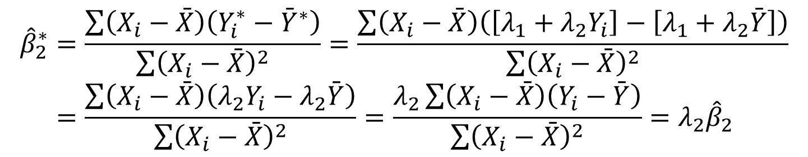


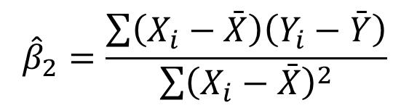
CHANGES IN THE UNITS OF MEASUREMENT: LINEAR TRANSFORMATION OF Y
$$Y_{i}=β_{1}+β_{2}X_{i}+u_{i}$$
$${\hat{β}}_{2}=\frac{\sum{\left(X_{i}−\bar{X}\right)\left(Y_{i}−\bar{Y}\right)}}{\sum{{\left(X_{i}−\bar{X}\right)}^{2}}}$$
$${\hat{Y}}_{i}={\hat{β}}_{1}+{\hat{β}}_{2}X_{i}$$
$$Y_{i}^{∗}=λ_{1}+λ_{2}Y_{i}$$
$${\hat{Y}}_{i}^{∗}={\hat{β}}_{1}^{∗}+{\hat{β}}_{2}^{∗}X_{i}$$
$${\hat{β}}_{2}^{∗}=\frac{\sum{\left(X_{i}−\bar{X}\right)\left(Y_{i}^{∗}−{\bar{Y}}^{∗}\right)}}{\sum{{\left(X_{i}−\bar{X}\right)}^{2}}}=\frac{\sum{\left(X_{i}−\bar{X}\right)\left(\left[λ_{1}+λ_{2}Y_{i}\right]−\left[λ_{1}+λ_{2}\bar{Y}\right]\right)}}{\sum{{\left(X_{i}−\bar{X}\right)}^{2}}} \\ =\frac{\sum{\left(X_{i}−\bar{X}\right)\left(λ_{2}Y_{i}−λ_{2}\bar{Y}\right)}}{\sum{{\left(X_{i}−\bar{X}\right)}^{2}}}=\frac{λ_{2}\sum{\left(X_{i}−\bar{X}\right)\left(Y_{i}−\bar{Y}\right)}}{\sum{{\left(X_{i}−\bar{X}\right)}^{2}}}=λ_{2}{\hat{β}}_{2}$$
The effect on the intercept: an exercise.
The effect of a change in the units of measurement of X: an exercise.

Slide 15



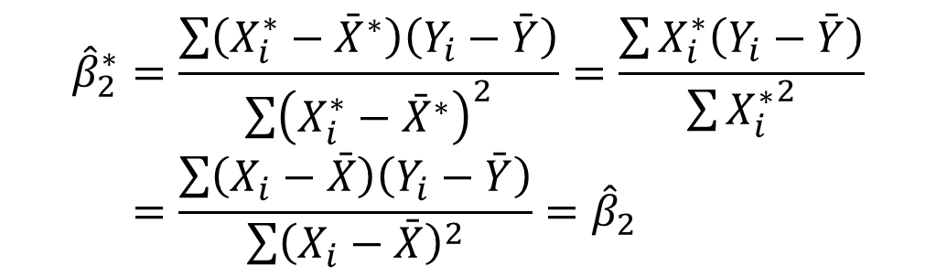


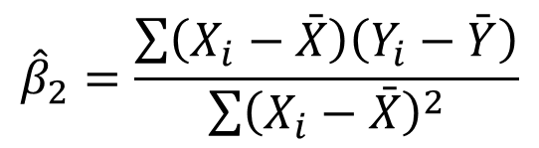

CHANGES IN THE UNITS OF MEASUREMENT: X* AS DEVIATION FROM THE MEAN
$$Y_{i}=β_{1}+β_{2}X_{i}+u_{i}$$
$${\hat{β}}_{2}=\frac{\sum{\left(X_{i}−\bar{X}\right)\left(Y_{i}−\bar{Y}\right)}}{\sum{{\left(X_{i}−\bar{X}\right)}^{2}}}$$
$${\hat{Y}}_{i}={\hat{β}}_{1}+{\hat{β}}_{2}X_{i}$$
$$X_{i}^{∗}=X_{i}−\bar{X}$$
$${\hat{Y}}_{i}={\hat{β}}_{1}^{∗}+{\hat{β}}_{2}^{∗}X_{i}^{∗}$$
$${\hat{β}}_{2}^{∗}=\frac{\sum{\left(X_{i}^{∗}−{\bar{X}}^{∗}\right)\left(Y_{i}−\bar{Y}\right)}}{\sum{{\left(X_{i}^{∗}−{\bar{X}}^{∗}\right)}^{2}}}=\frac{\sum{X_{i}^{∗}\left(Y_{i}−\bar{Y}\right)}}{\sum{{X_{i}^{∗}}^{2}}} \\ =\frac{\sum{\left(X_{i}−\bar{X}\right)\left(Y_{i}−\bar{Y}\right)}}{\sum{{\left(X_{i}−\bar{X}\right)}^{2}}}={\hat{β}}_{2}$$
$${\bar{X}}^{∗}=0$$
$${\hat{β}}_{1}^{∗}=\bar{Y}−{\hat{β}}_{2}^{∗}{\bar{X}}^{∗}=\bar{Y}$$
The intercept is now the fitted value of Y at the sample mean of X, this is the sample mean of Y.

Slide 16
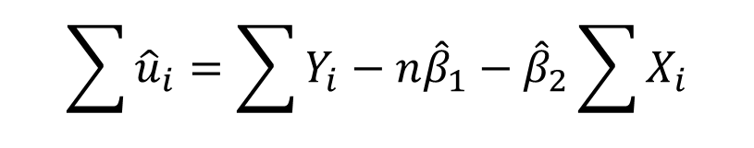



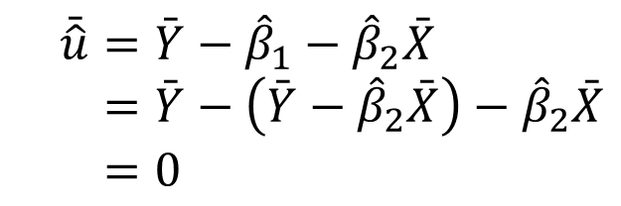
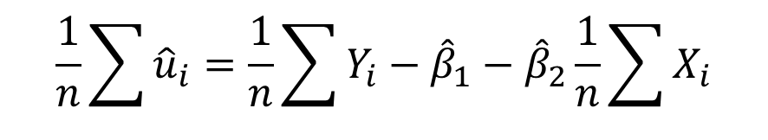
GOODNESS OF FIT
Four useful results: 1)
$$\bar{\hat{u}}=0$$
$${\hat{u}}_{i}=Y_{i}−{\hat{Y}}_{i}=Y_{i}−{\hat{β}}_{1}−{\hat{β}}_{2}X_{i}$$
$$\sum{{\hat{u}}_{i}}=\sum{Y_{i}}−n{\hat{β}}_{1}−{\hat{β}}_{2}\sum{X_{i}}$$
$$\frac{1}{n}\sum{{\hat{u}}_{i}}=\frac{1}{n}\sum{Y_{i}}−{\hat{β}}_{1}−{\hat{β}}_{2}\frac{1}{n}\sum{X_{i}}$$
$$\bar{\hat{u}}=\bar{Y}−{\hat{β}}_{1}−{\hat{β}}_{2}\bar{X} \\ =\bar{Y}−\left(\bar{Y}−{\hat{β}}_{2}\bar{X}\right)−{\hat{β}}_{2}\bar{X} \\ =0$$
$${\hat{β}}_{1}=\bar{Y}−{\hat{β}}_{2}\bar{X}$$

Slide 17
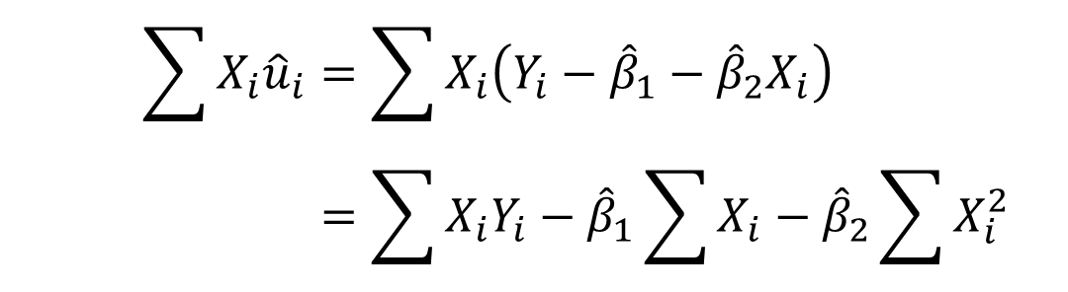


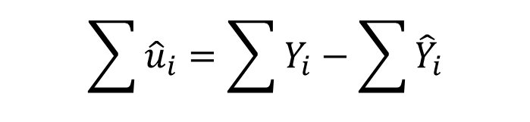

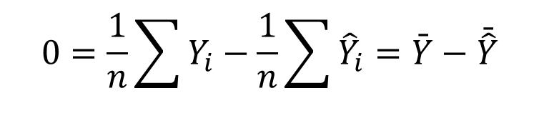

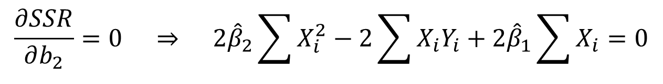
$$\sum{X_{i}{\hat{u}}_{i}}=0$$
$$\bar{\hat{Y}}=\bar{Y}$$
Useful results: 2) 3)
$$\sum{{\hat{u}}_{i}}=\sum{Y_{i}}−\sum{{\hat{Y}}_{i}}$$
$${\hat{u}}_{i}=Y_{i}−{\hat{Y}}_{i}$$
$$0=\frac{1}{n}\sum{Y_{i}}−\frac{1}{n}\sum{{\hat{Y}}_{i}}=\bar{Y}−\bar{\hat{Y}}$$
$$\bar{\hat{Y}}=\bar{Y}$$
$$\sum{X_{i}{\hat{u}}_{i}}=\sum{X_{i}\left(Y_{i}−{\hat{β}}_{1}−{\hat{β}}_{2}X_{i}\right)} \\ =\sum{X_{i}Y_{i}}−{\hat{β}}_{1}\sum{X_{i}}−{\hat{β}}_{2}\sum{X_{i}^{2}}=0$$
$$\frac{∂SSR}{∂b_{2}}=0 ⇒ 2{\hat{β}}_{2}\sum{X_{i}^{2}}−2\sum{X_{i}Y_{i}}+2{\hat{β}}_{1}\sum{X_{i}}=0$$

Slide 18

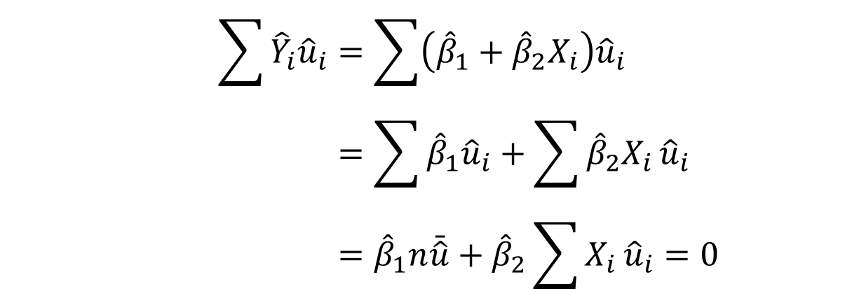


$$\sum{{\hat{Y}}_{i}{\hat{u}}_{i}}=0$$
Useful results: 4)
$$\sum{{\hat{Y}}_{i}{\hat{u}}_{i}}=\sum{\left({\hat{β}}_{1}+{\hat{β}}_{2}X_{i}\right){\hat{u}}_{i}} \\ =\sum{{\hat{β}}_{1}{\hat{u}}_{i}}+\sum{{\hat{β}}_{2}X_{i}}{\hat{u}}_{i} \\ ={\hat{β}}_{1}n\bar{\hat{u}}+{\hat{β}}_{2}\sum{X_{i}}{\hat{u}}_{i}=0$$
$$\sum{X_{i}{\hat{u}}_{i}}=0$$
$$\bar{\hat{u}}=0$$

Slide 19
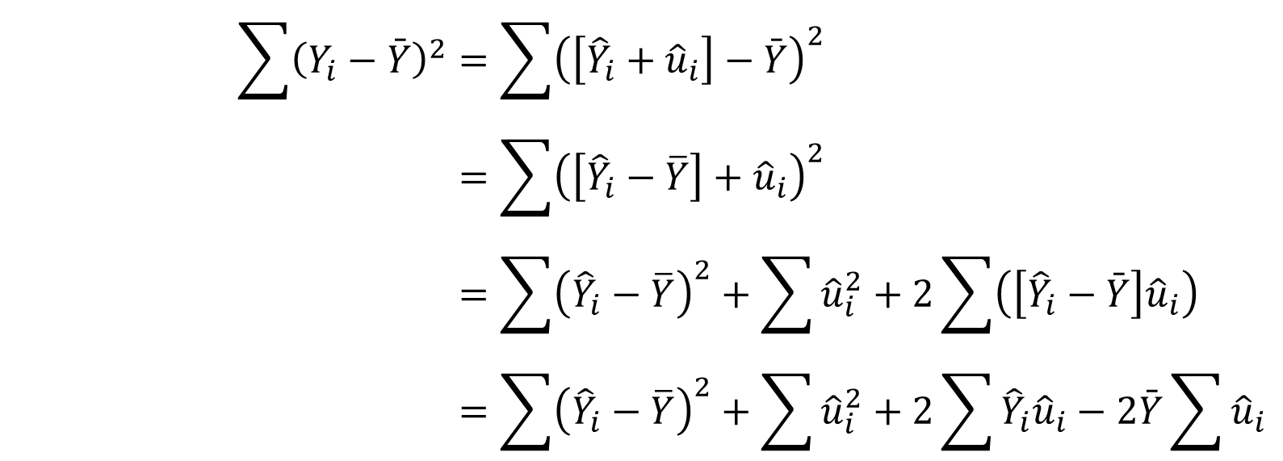




Useful results: SST=SSE+SSR
$$\sum{{\left(Y_{i}−\bar{Y}\right)}^{2}}=\sum{{\left(\left[{\hat{Y}}_{i}+{\hat{u}}_{i}\right]−\bar{Y}\right)}^{2}} \\ =\sum{{\left(\left[{\hat{Y}}_{i}−\overline{Y}\right]+{\hat{u}}_{i}\right)}^{2}} \\ =\sum{{\left({\hat{Y}}_{i}−\overline{Y}\right)}^{2}}+\sum{{\hat{u}}_{i}^{2}}+2\sum{\left(\left[{\hat{Y}}_{i}−\bar{Y}\right]{\hat{u}}_{i}\right)} \\ =\sum{{\left({\hat{Y}}_{i}−\overline{Y}\right)}^{2}}+\sum{{\hat{u}}_{i}^{2}}+2\sum{{\hat{Y}}_{i}{\hat{u}}_{i}}−2\bar{Y}\sum{{\hat{u}}_{i}}$$
$$SST=SSE+SSR$$
$$\sum{{\left(Y_{i}−\overline{Y}\right)}^{2}}=$$
SST, sum of squares total
$$\sum{{\left({\hat{Y}}_{i}−\overline{Y}\right)}^{2}}=$$
SSE, sum of squares explained
$$\sum{{\hat{u}}_{i}^{2}}=$$
SSR, sum of squared residuals

Slide 20
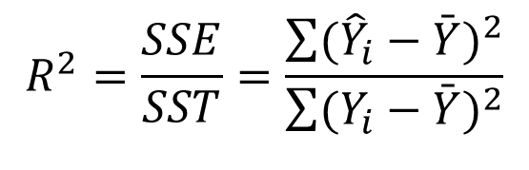
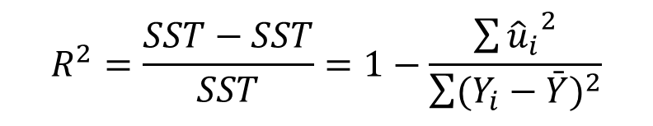

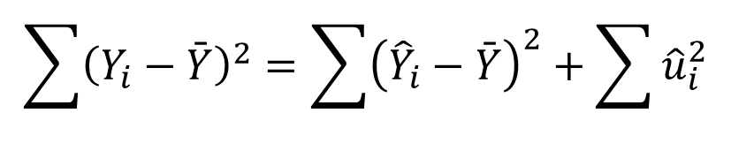
Useful results: R²
$$\sum{{\left(Y_{i}−\bar{Y}\right)}^{2}}=\sum{{\left({\hat{Y}}_{i}−\bar{Y}\right)}^{2}}+\sum{{\hat{u}}_{i}^{2}}$$
$$SST=SSE+SSR$$
$$R^{2}=\frac{SSE}{SST}=\frac{\sum{({\hat{Y}}_{i}−\bar{Y})^{2}}}{\sum{(Y_{i}−\bar{Y})^{2}}}$$
$$R^{2}=\frac{SST−SST}{SST}=1−\frac{\sum{{{\hat{u}}_{i}}^{2}}}{\sum{(Y_{i}−\bar{Y})^{2}}}$$

Slide 21
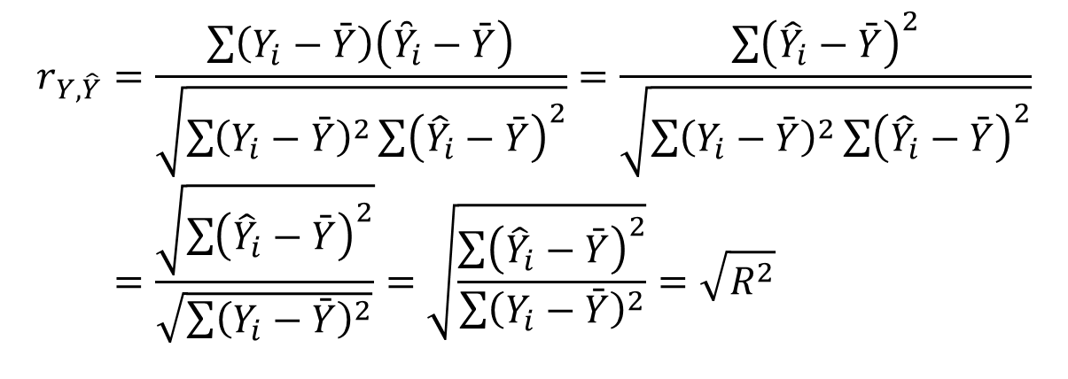
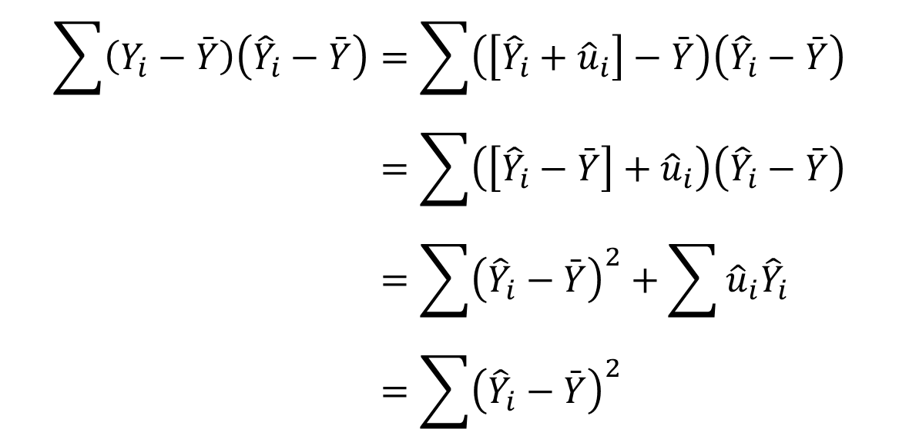
$$r_{Y,\hat{Y}}=\frac{\sum{\left(Y_{i}−\bar{Y}\right)\left({\overset{̑}{Y}}_{i}−\bar{Y}\right)}}{\sqrt{\sum{{\left(Y_{i}−\bar{Y}\right)}^{2}}\sum{{\left({\hat{Y}}_{i}−\bar{Y}\right)}^{2}}}}=\frac{\sum{{\left({\hat{Y}}_{i}−\bar{Y}\right)}^{2}}}{\sqrt{\sum{{\left(Y_{i}−\bar{Y}\right)}^{2}}\sum{{\left({\hat{Y}}_{i}−\bar{Y}\right)}^{2}}}} \\ =\frac{\sqrt{\sum{{\left({\hat{Y}}_{i}−\bar{Y}\right)}^{2}}}}{\sqrt{\sum{{\left(Y_{i}−\bar{Y}\right)}^{2}}}}=\sqrt{\frac{\sum{{\left({\hat{Y}}_{i}−\bar{Y}\right)}^{2}}}{\sum{{\left(Y_{i}−\bar{Y}\right)}^{2}}}}=\sqrt{R^{2}}$$
$$\sum{\left(Y_{i}−\bar{Y}\right)\left({\hat{Y}}_{i}−\bar{Y}\right)}=\sum{\left(\left[{\hat{Y}}_{i}+{\hat{u}}_{i}\right]−\bar{Y}\right)\left({\hat{Y}}_{i}−\bar{Y}\right)} \\ =\sum{\left(\left[{\hat{Y}}_{i}−\bar{Y}\right]+{\hat{u}}_{i}\right)\left({\hat{Y}}_{i}−\bar{Y}\right)} \\ =\sum{{\left({\hat{Y}}_{i}−\bar{Y}\right)}^{2}}+\sum{{\hat{u}}_{i}{\hat{Y}}_{i}}−\bar{Y}\sum{{\hat{u}}_{i}} \\ =\sum{{\left({\hat{Y}}_{i}−\bar{Y}\right)}^{2}}$$

Slide 22
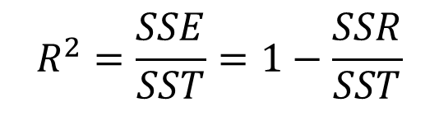
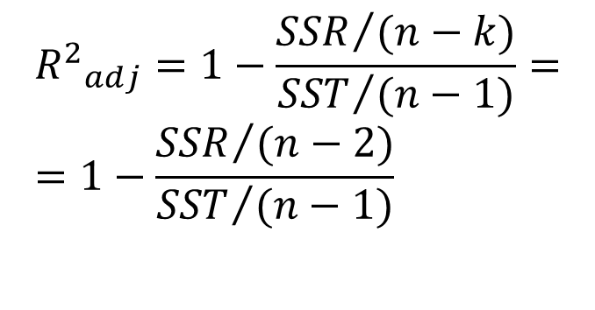
R² and Adjusted R²
$$R^{2}=\frac{SSE}{SST}=1−\frac{SSR}{SST}$$
Determination coefficient R² always grows if an explanatory variable
has been added, either significant or not. The adjusted coefficient was
introduced which may increase or decrease:
$${R^{2}}_{adj}=1−\frac{{SSR}/{(n−k)}}{{SST}/{(n−1)}}= \\ =1−\frac{{SSR}/{(n−2)}}{{SST}/{(n−1)}}$$
The R²_{adj} coefficient is not widely used for econometric analysis though available in the regression printouts.

Slide 23
SLR Model: Gini (2019) and real GDP growth rates (2019), 59 countries

Slide 24
SLR Model: Real GDP (PPP) per capita and Life expectancy at birth (2020), 182 countries

Slide 25
Real GDP per capita (GDPpc, USD, PPP, 2017) and Life Expectancy at birth (LifeExp), Russia, 1990-2020 (time series!)

